Slide 1
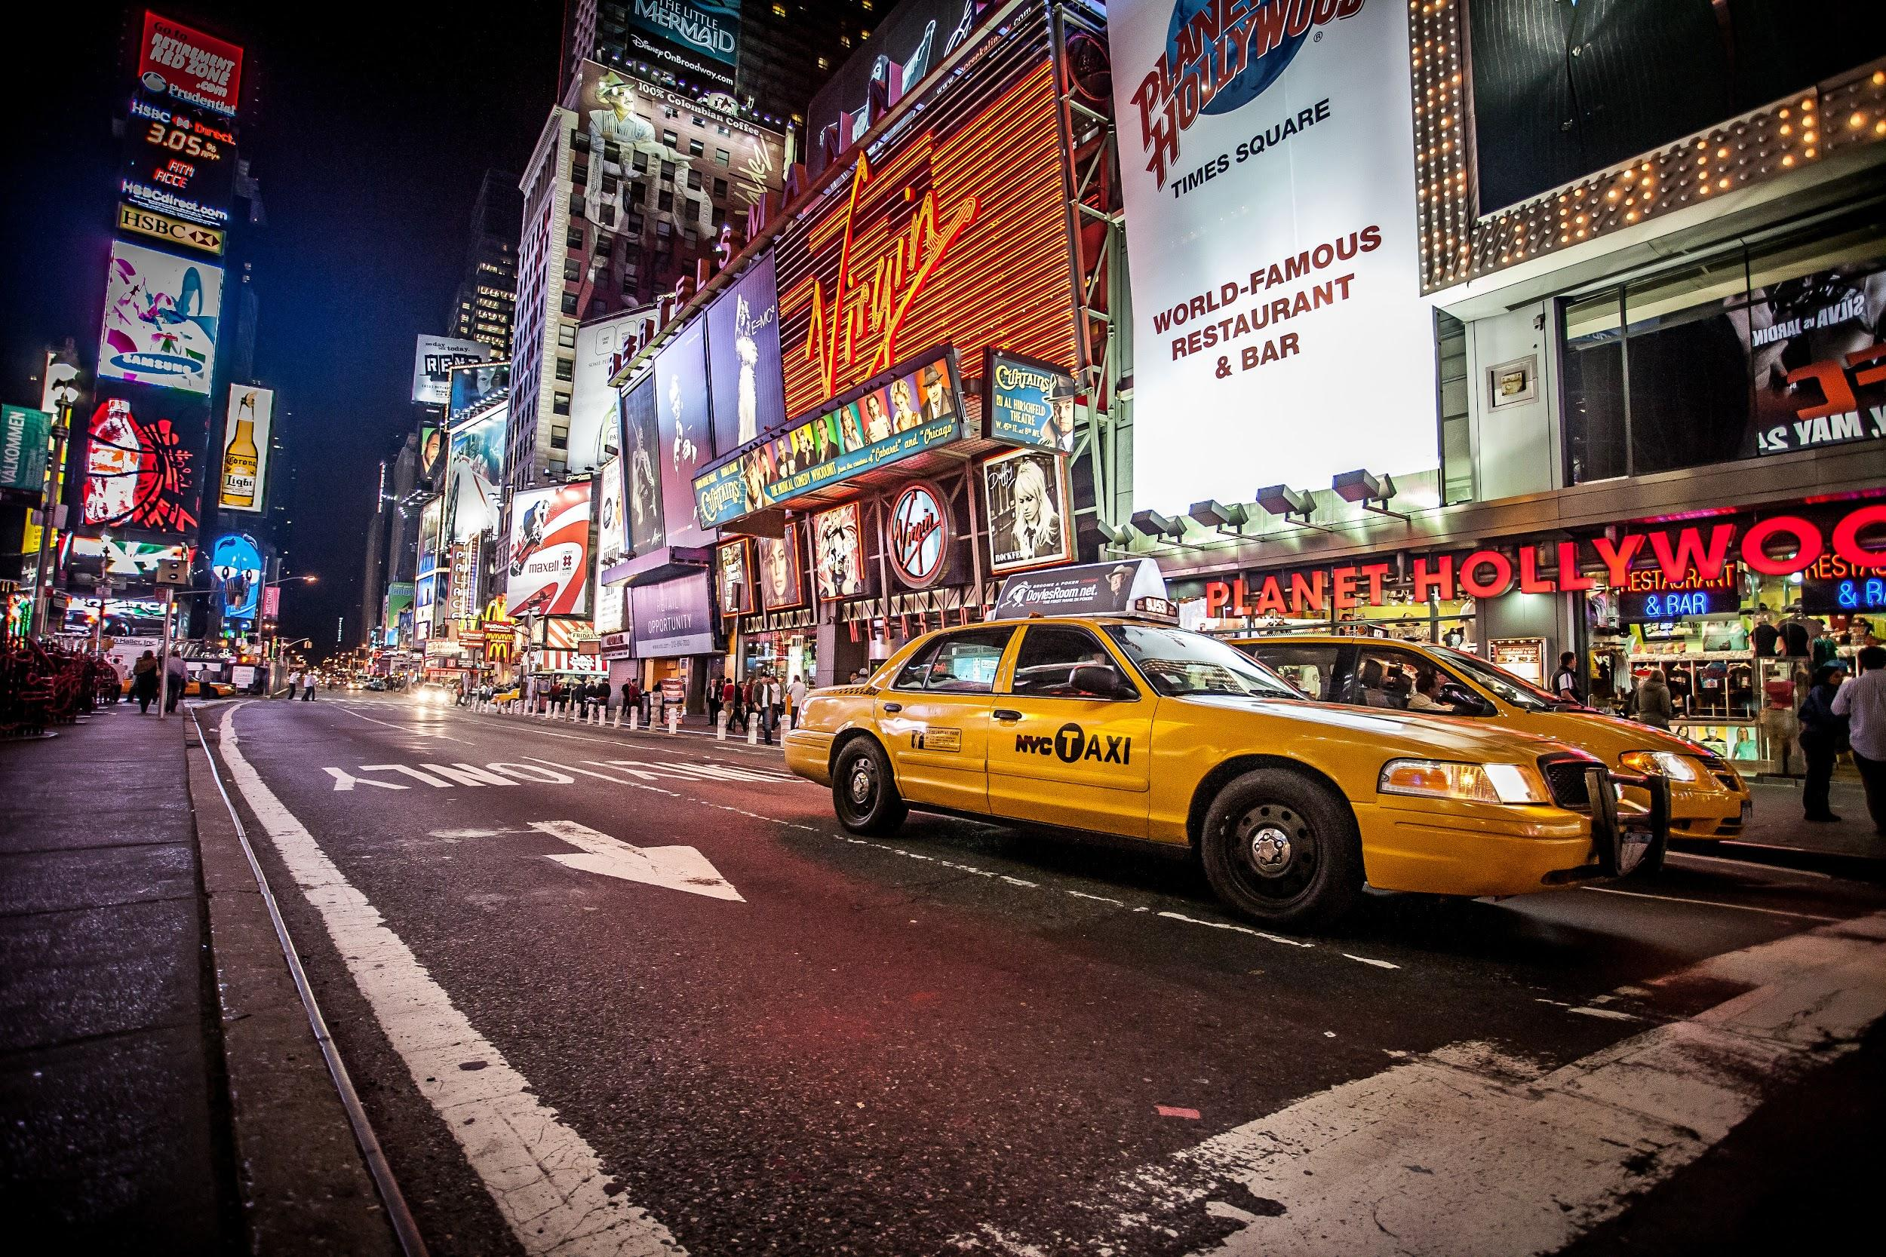
NYC
TAXI
I
ZYMIC
Zheng Chai, Yuan-Yao Chang, Michael Chon, Chong Zhang

Slide 2
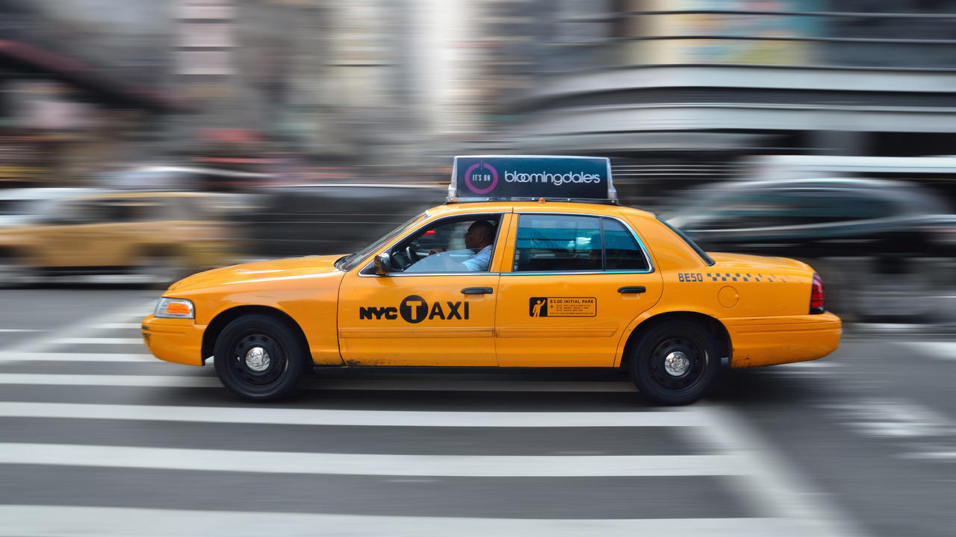
I
Introduction

Slide 3



Since the rise of the Uber empire,
Too many “transportation network” companies in NYC
Brought a lot of problems to NYC

Slide 4
Main Problem: Competition
Since more taxi services available, less money for NYC yellow cab drivers
I

Slide 5
Another Problem:
City Congestion
the number of yellow cabs = 13605
the number of Uber cars = 43105
the number of lyft cars = 16847
Approximately, 73000 taxi-related cars on NYC streets
I

Slide 6
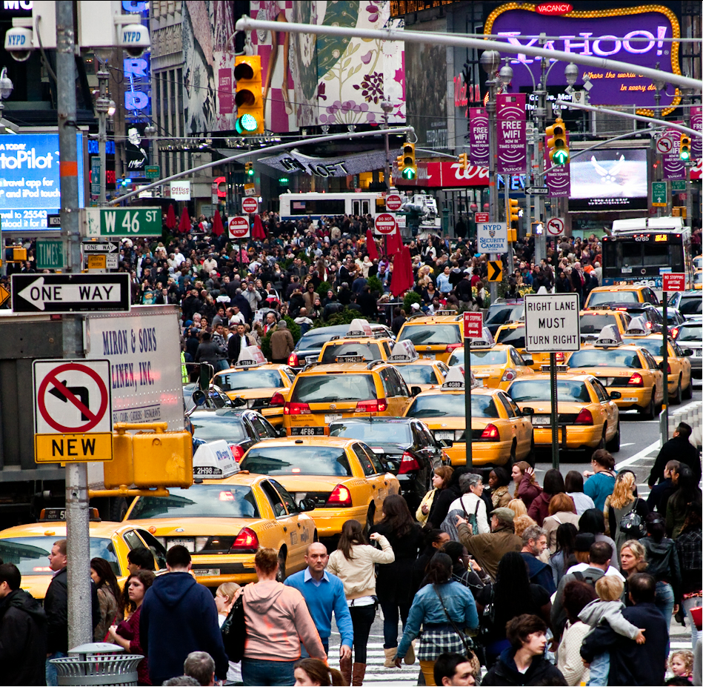
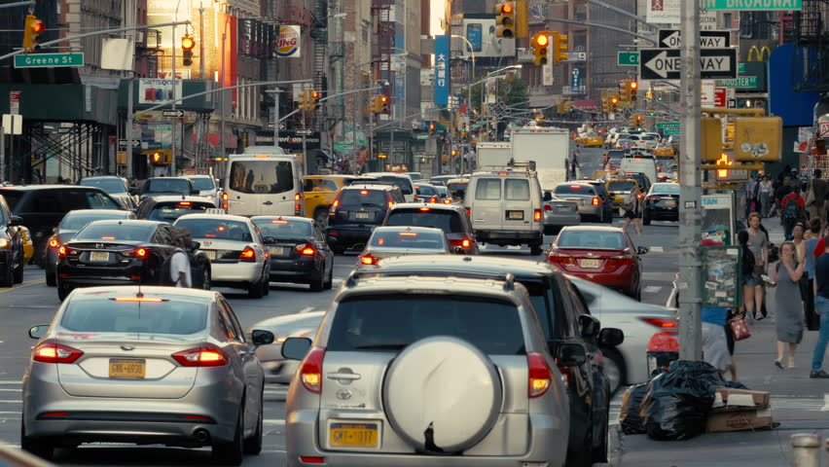
IMAGINE
Notes:
https://pixabay.com/en/office-sitting-room-executive-730681/
https://pixabay.com/en/imac-ipad-computer-tablet-mobile-605421/

Slide 7
I
Why are NYC yellow cabs important to the city?

Slide 8
Taxes collected from NYC yellow cabs go towards
To Improving the NYC public transit system!

Slide 9

Concern
Suppose mayor Bill de Blasio comes and asks for help:
Hands out the one year worth dataset collected in 2016
“What strategies can NYC yellow cab drivers make more profits?”

Slide 10
OUR STEPS
Data Cleaning
Analysis-1
Analysis-2
Conclusion
Outliers
Error data
New Groups
K-means Clustering
LineGraph
HeatMap
Machine Learning
Help Taxi Driver earn more profit
Tools:
Python, Spark, AWS EMR, S3

Slide 11
I
DataSet

Slide 12
The original dataset
The dataset contains the data collected from 1-2016 to 12-2016
''The data used in the attached datasets were collected and provided to the NYC Taxi and Limousine Commission (TLC) by technology providers authorized under the Taxicab & Livery Passenger Enhancement Programs (TPEP/LPEP)''

Slide 13
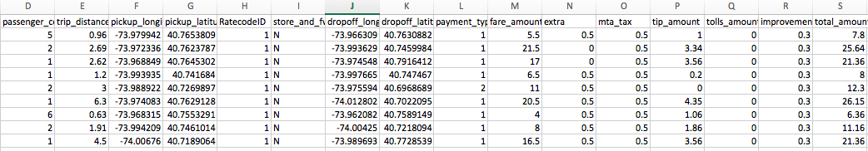
Attributes
“distance,pickup_longitude,pickup_latitude,dropoff_longitude,dropoff_latitude,tpep_pickup_date” and etc.

Slide 14
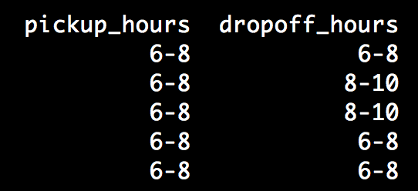
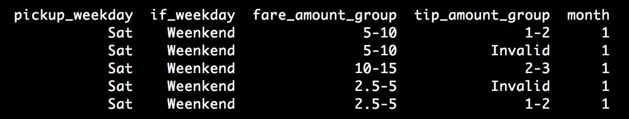
Data Cleaning
New Attributes
There are unnecessary attributes such as Store_and_fwd_flag, VendorID, etc.
There are many errors in the dataset: the total_fare_amount is less than $2.50 and pickup_latitude and longitude were the same to the dropoff_latitude and longitude
Fare_group
$2.50 - $5 =>1 , $5 - $10 =>2, $15 - $20 => 3, ...
Tip_group
$0 - $1 =>1, $1 - $2 =>2, $2 - $3 =>3, …
>$20, invalid
if_weekday
Weekday or Weekend

Slide 15
I
Analysis-1

Slide 16
I
K-means Clustering

Slide 17
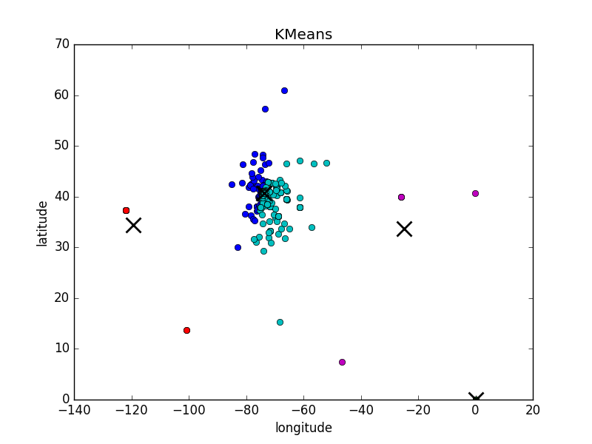
Before Cleaning
There were many outliers
For some trips, their pick-up latitude and longitude are equal to drop-off latitude and longitude

Slide 18
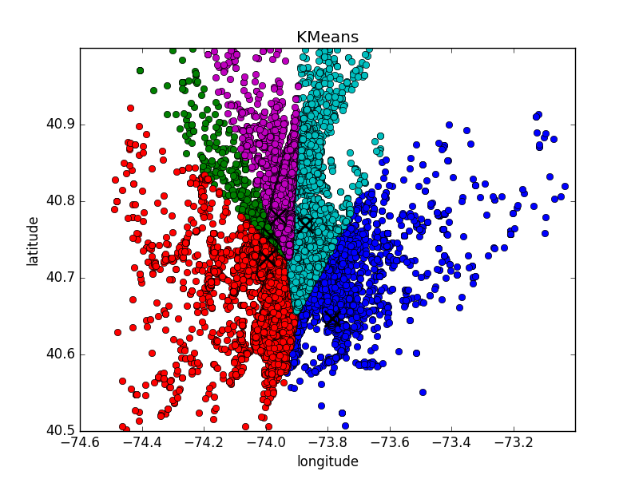
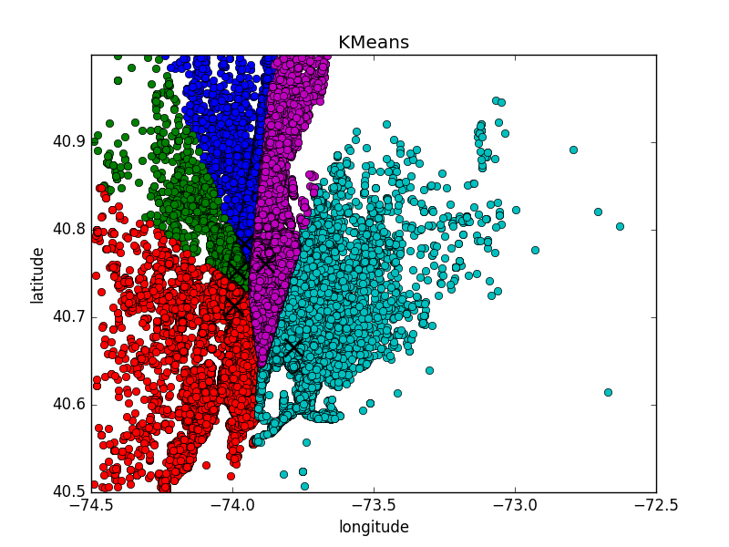
After Cleaning, K = 5
DROP-OFF
PICK-UP

Slide 19
5 Centroids for Pick-up
JFK
LGA
Soho, NYU
Time Square
Metropolitan Museum

Slide 20
5 Centroids for Drop-off
Cooper Hewitt Smithsonian Design Museum (5 Ave & E 91st)
Bryant Park (42nd st & 5th ave)
94b E Broadway (Near Chinatown)
Holiday Inn Express New York JFK Airport Area
Gorman Playground (3 blocks away from LGA)

Slide 21
Based on K-means clustering with K=5, the popular pick-up and drop-off locations are
1. JFK airport
2. Laguardia airport
3. Metropolitan Museum
4. Bryant Park

Slide 22
K = 1, …, 20 Centroids for Pick-up
Newark airport
Williamsburg, Downtown Brooklyn
Grand Central Terminal
Upper West (72nd, 98th st & Amsterdam ave)
Chelsea, Hell’s Kitchen, 23rd st & Park ave,

Slide 23
Based on 20 K-means clustering analysis,
More centroids are found around midtown than in uptown. More centroids represent higher densities around clusters.
Therefore,
more pickups generally happen close to midtown areas.

Slide 24
I
Analysis-1

Slide 25
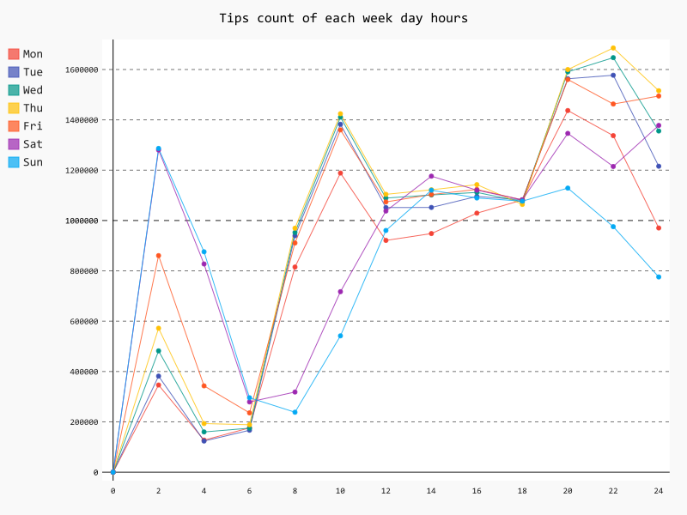
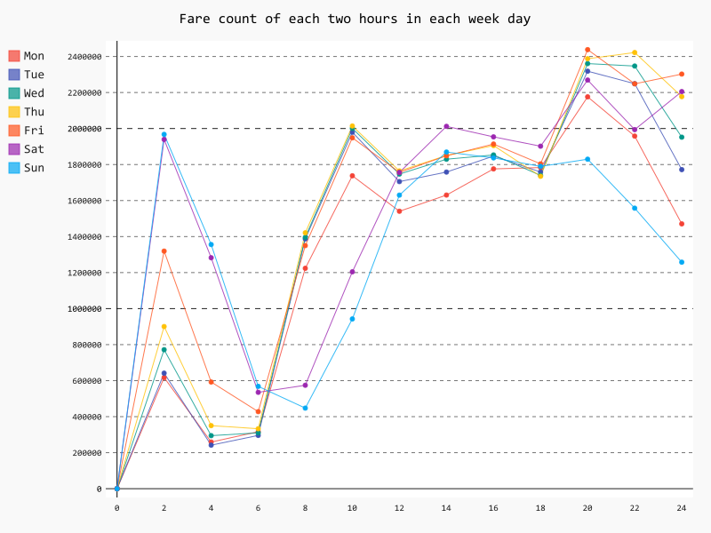
Total Tip frequency vs Pickup(fare) frequency
Based on hours

Slide 26
On Sat and Sun, many pickups and tips occur in 0-2 time period (0:00-2:00AM) due to nightlife in NYC
On weekdays, many pickups and tips occur in 6-10 (6:00-10:00 AM) and 18-20 (6:00-8:00 PM) due to rush hour
On Thursday, tips occur the most during 20-22 (8:00-10:00 PM)
On Friday, pickups occur the most during 18-20 (6:00-8:00 PM)

Slide 27
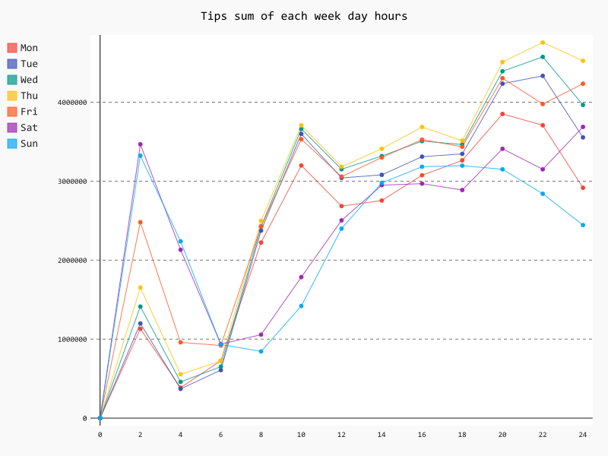
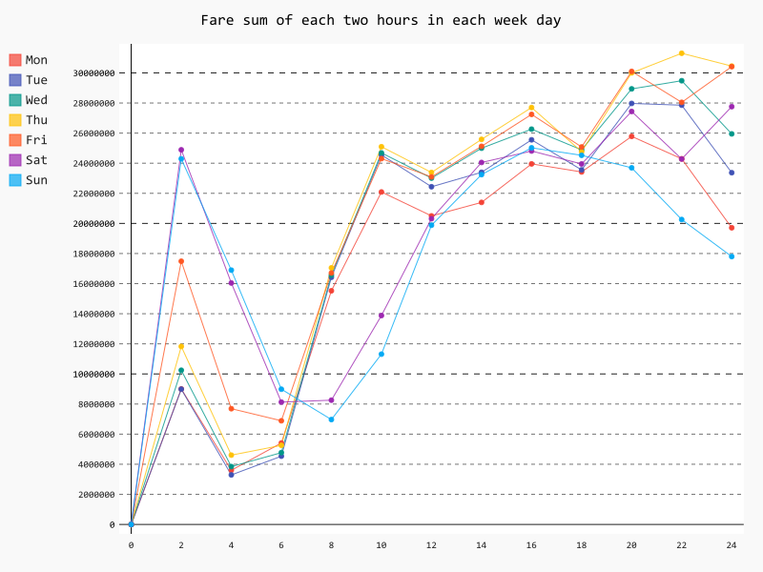
Total Tip sum vs Fare sum
Based on hours

Slide 28
Customers tend to pay more tips on Thursday night around 10:00 - 12:00 PM
The total fare amounts are greater on Friday than Thursday because of more taxi rides on Friday.

Slide 29
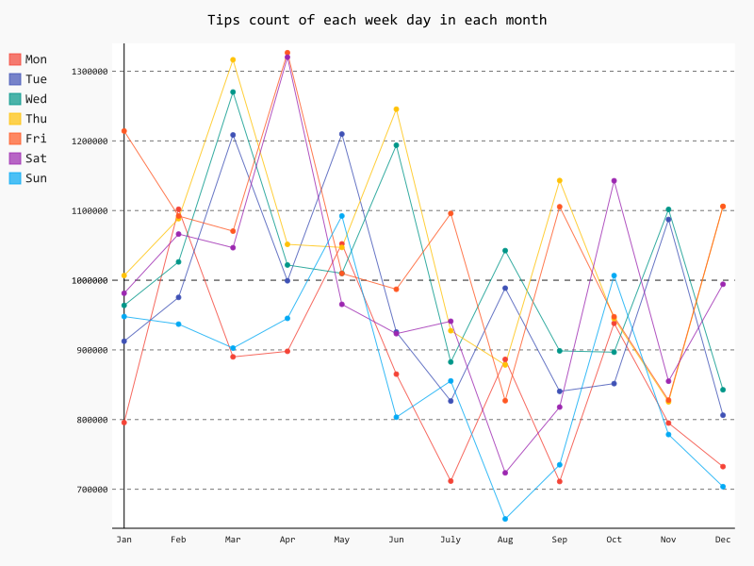
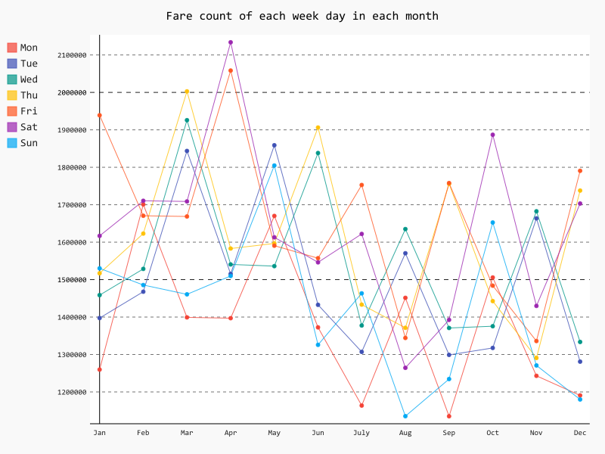
Total Tip frequency vs Pickup(fare) frequency
Based on months

Slide 30
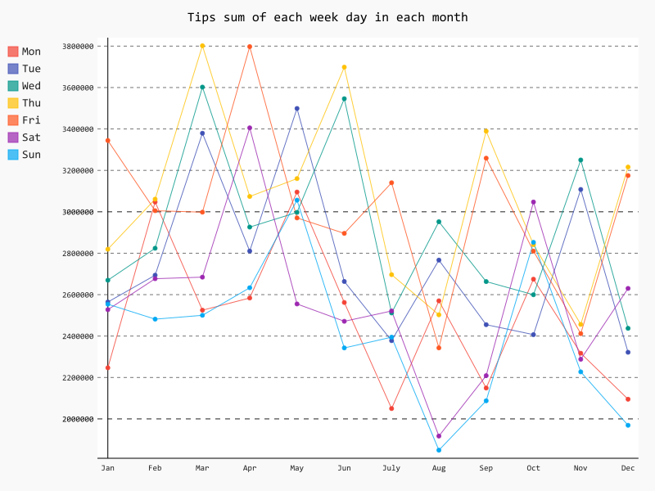
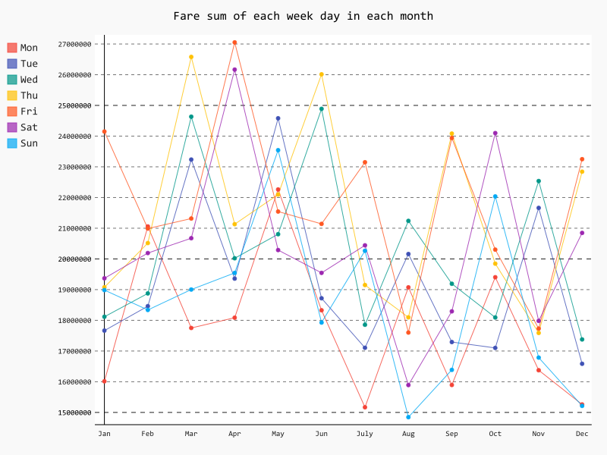
Total Tip sum vs Fare sum
Based on months

Slide 31
Pickups occur the most on Sat in April
Tips occur the most on Fri and Sat in April

Slide 32
On Thursday, total fare amounts increase January to March April to June July to August November to December
On Friday, total fare amounts increase March to April August to September November to December

Slide 33
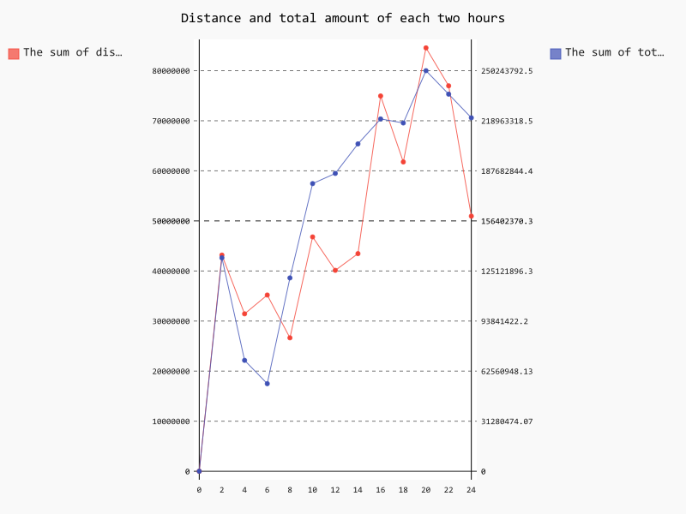
Distance and Total fare in hours
To maximize the profits, the sum of fare amounts > the sum of distance
Based on the graph, 8:00 AM - 2:00 PM 4:00 PM - 6:00 PM 10:00 PM - 12:00 PM

Slide 34
I
Analysis-2

Slide 35
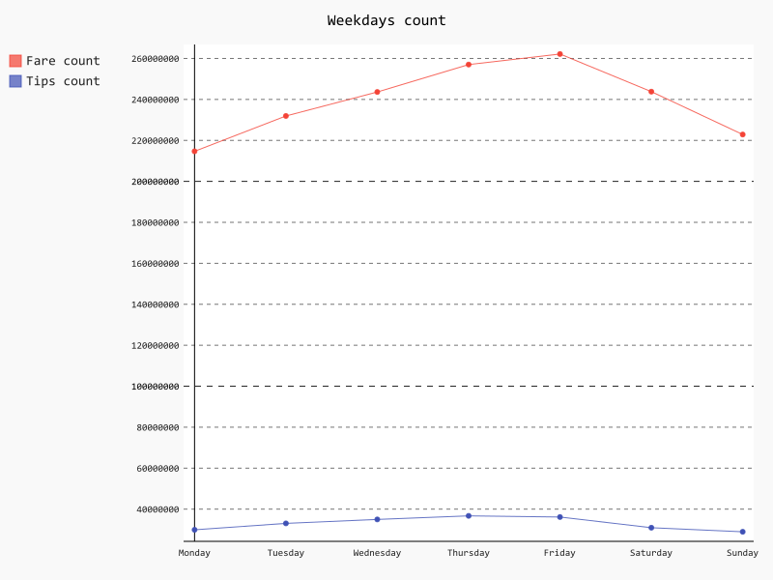
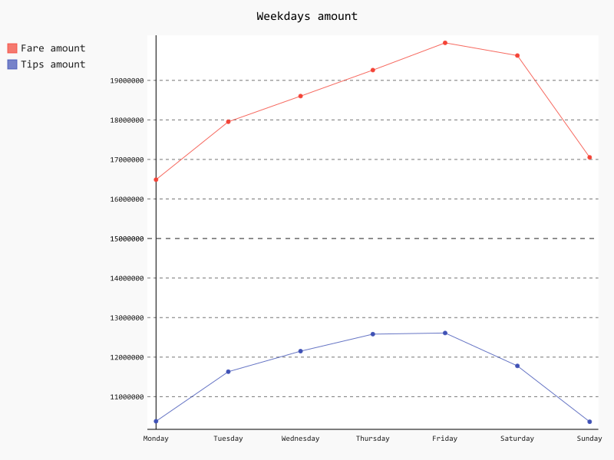
Pick-up count and Fare sum in week

Slide 36
Overall,
Friday is the most profitable day in a week

Slide 37
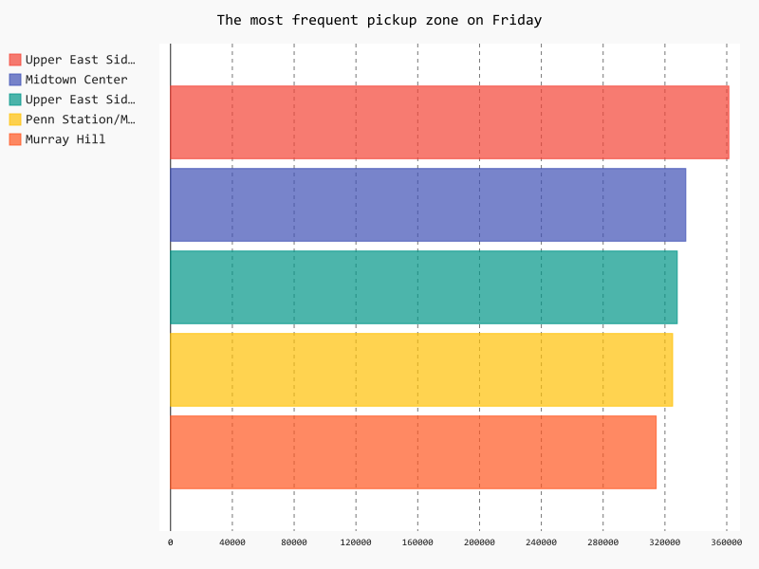
Friday

Slide 38
Friday
Upper East Side is the most popular pick-up location on Friday, in general.
During 4:00-8:00 AM, the most pick-up occurs around Penn Station
During 8:00 AM-8:00 PM, the most pick-up occurs in Upper East Side
During 8:00 PM-4:00 AM, the most pick-up occurs in East Village

Slide 39
I
HeatMap

Slide 40
HeatMap on Friday

Slide 41
Closer Look

Slide 42
I
Random Forest

Slide 43
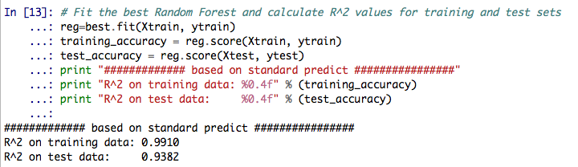
Why Random Forest?
According to Wikipedia, it is one of the most accurate learning algorithms.
Random Forest Algorithm fully utilizes the datasets, and it estimates what variables are important in the classification.
Our Random Forest Model has a training accuracy of 0.9918, and a test accuracy of 0.9382.

Slide 44
What if we extend to the whole week?
Based on the Random Forest Model we have trained, we can not only do prediction for Friday.
The training accuracy and testing accuracy will remain the same.
The original dataset is the same.
The split method is the same.
Training dataset and test dataset are the same.

Slide 45
Heat map on predicted Friday pick-up by every 4 hour

Slide 46
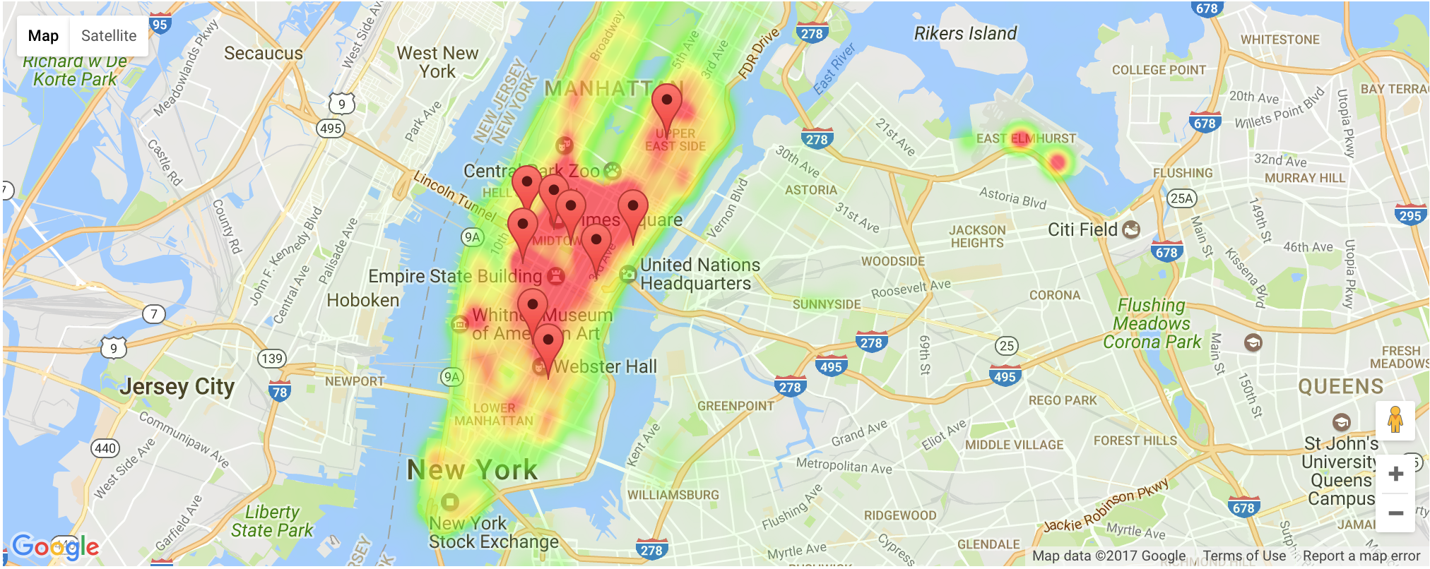
Heat map on the entire predicted Friday

Slide 47
The pins represent actual pick-up locations. As seen before, the heat map produced on the predicted data captures the actual pick-up locations on map very well.

Slide 48
I
Conclusion

Slide 49
The profitable days to drive are Thursday, Friday, and Saturday
Thurs | Fri | Sat
10:00 AM - 12:00 PM | 10:00 AM - 2:00 AM (SAT) | 2:00 PM - 12:00 PM
3.
Thurs | Fri | Sat
Feb - March May - June Aug - Sep Nov - Dec | Mar - Apr Aug - Sep Nov - Jan | Mar - Apr Aug - Sep Nov - Jan

Slide 50
4. Based on the result of the Random Forest model , we obtained a test accuracy of 94%, so our predictions are incredibly reliable. We can predict for drivers
5. The top five pick up locations are:
Upper East Side South
Midtown Center
Penn Station/Madison Sq West
Upper East Side North
Midtown East

Slide 51
I
Limitations

Slide 52
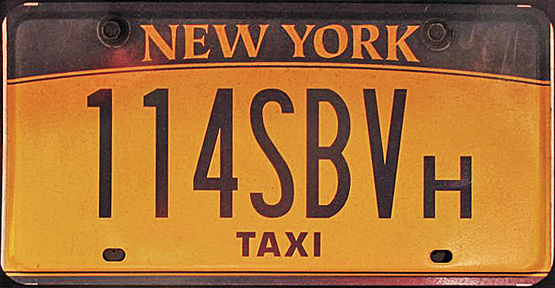
License Plate
We can only track one ride
Not able to track the same car same driver.
It will be more meaningful if we can identify drivers, and compare the data among different drivers.

Slide 53
Density too high
This is seperated by Monday - Sunday for 6 month.
Ride frequency is way too high in Manhattan compare to other boroughs
Nearly, no changes are observed on the heat map

Slide 54




OUR
TEAM
Zheng Chai
Yuan-Yao Chang
zc104@georgetown.edu
yc704@georgetown.edu
Michael Chon
Chong Zhang
mc2153@georgetown.edu
cz211@georgetown.edu

